Slide 1
URINARY TRACT INFECTIONS IN CHILDREN
Prof. G. W. Irimu, PhD, MMed
Consultant Paediatrician / Nephrologist
University of Nairobi
Prof Irimu G W

Slide 2
Outline
Importance of the topic & Definition
Causes of UTI
Risk factors of UTI
Pathogenesis
Diagnosis
  - clinical manifestation,
  - urine collection methods
  - laboratory diagnosis
Antibiotic treatment
Evaluation of the risk factors
Follow up
Prof Irimu G W

Slide 3
WHY DISCUSS UTI’s
Mortality from acute disease rare, can arise esp. in neonates due to shock and septicemia.
Long term sequel
Hypertension
Chronic renal
insufficiency
ESRD
Protenuria
Complications during
pregnancy
Prof Irimu G W

Slide 4
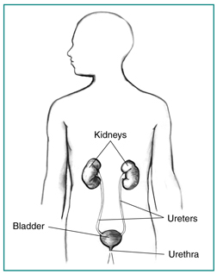

Prof Irimu G W
Notes:
UTI in Children

Slide 5
Definition
UTI – presence of bacteria within the urine (bacteruria) which when cultured is measured in colony forming units of uncentrifuged urine
UTI classified
  asymptomatic bacteruria,
  Cystitis (bladder involvement)
  Pyelonephritis (involvement of renal parenchyma)
Prof Irimu G W

Slide 6
Causes (Bacterial)
Majority of causative bacteria are bowel commensals, which ascend the UT.
E.Coli accounts for 80% - 90% of 1st time UTI’s in children.
Others - Klebsiella,Proteus( esp in boys),
Staph.saprophyticus,
Pseudomonas,S.aureus / epidermidis ,Citrobacter- common in pts with impaired host defences.
(Lactobacillus spp, coagulase-negative and corynebacterium spp not considered clinically important)
Prof Irimu G W

Slide 7
Risk factors for UTI in children
Bacteria which cause UTI usually originate from the bowel.
Host properties
Disturbance of urinary flow- urine stasis: (bacteria are eliminated from the bladder by uroepithelia cells & bladder emptying).
Vescical ureteric reflux
Obstructive malformation-PUV, meatal stenosis, labia adhesion
Poor voiding habits (voiding dysfunction )
Neuropathic bladder
Calculi
Constipation
Prof Irimu G W
Notes:
Poor voiding habits – during toilet training and due to infrequent bladder emptying.
UTI in Children

Slide 8
ct/Risk factors for UTI in children
Alteration of normal defence mech….periurethra flora( diptheroids. Streptococcal sp, lactobacilli.. 2⁰ to use of antibiotics.
Sexual activity, masturbation
Girls ---Short urethra in girls, cleaning method important
Uncircumcised boys (X4 to 20 times)
*Absence of another source of infection in a febril child
Prof Irimu G W

Slide 9
Ct/Risk factors for UTI in children
Bacterial properties
Virulence of the bacteria
Adhesion of the bacteria- P-fimbriated bacteria (type 2 fimbriae) more adherent; high risk for pyelonephritis
Prof Irimu G W

Slide 10
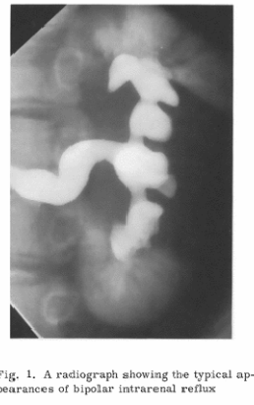
Pathogenesis
Ascending infection
Simple & Compound papillae have antireflux mechanism
Some compound papillae locate in upper and lower poles allow intra-renal reflux
Infected urine stimulate immunological and anti-inflammatory response
Renal injury and scarring
Risk of scarring high <age 2yrs
Prof Irimu G W
Notes:
Compound papillae occur predominantly in the upper and lower poles.
In compound papillae the collecting ducts fuse, making access of the refluxed urine more likely than in the simple cone shaped papillae
Ascending infection – bacterial arise form fecal flora. In uncircumcised boys the bacterial pathogen arise form the flora beneath the prepuce
UTI in Children

Slide 11
DIAGNOSIS
Presentation depends on age and level of Infection ( bladder v/s kidneys).
Neonates & Infants.
Non specific signs - fever often lacking,
- apathy
- anorexia
- vomitting
- feeding problems
- grayish colour
- jaundice
Prof Irimu G W

Slide 12
Clinical manifestations
Acute pyelonephritis | Cystitis
Abdominal /flank pain Systemic features eg High fever > 38.5 c Rigors loin tenderness vomiting Delirious | Bladder involvement and symptoms Dysuria ( r/o local inflammation by examining the genital area) frequency Urgency Cloudy urine (DOES not cause RENAL injury)
Asymptomatic bacteriuria
Positive culture but no manifestation (almost exclusively in girls). The key to distinguishing true UTI from asymptomatic bacteriuria is the presence of pyuria.
Prof Irimu G W
Notes:
UTI in Children

Slide 13
Physical examination
Unrewarding
Abdomen - enlarged kidneys
- Feacal masses
-Loin/ suprapubic tenderness
Genitalia r/o vulvitis, balanitis
CNS examine back, lower extremities
Prof Irimu G W

Slide 14
Laboratory Diagnosis
Urine culture - “gold standard’’
- however false diagnosis of UTI possible due to contamination during passage from bladder to the sample container.
Quality of Urine sample crucial.
Importance:
  Missed diagnosis may lead to renal scarring
  Over-diagnosis can lead to over-treatment and unnecessary imaging
  Once Rx is started opportunity for diagnosis is lost
Prof Irimu G W

Slide 15
IDEAL SAMPLE OF VOIDED URINE
Midstream specimen with long bladder time.
Urine collected after uncovering urethra orifice
Fresh urine sample ( < 1hr old) / refrigerated at 4⁰ c
Prof Irimu G W

Slide 16
Methods of Urine collection
Bag urine | Unacceptably high false-positive. Negative results useful. If initiation of a/b Rx is required consider catheterization of SPA
Clean catch urine collection
Midstream specimen of urine (MSSU)*
Catheterization* | Has sensitivity (95%) and specificity (99%) compared to SPA
Supra-pubic aspirate (SPA) | Obtains urine that is not contaminated by perineal flora. U/S guidance increases success. Perceived as invasive by many parents and clinicians. May be the choice in moderate-severe phimosis or tight labia adhesions
Initial volume contaminated by bacteria in the distal urethra - discard
Bacteriurua significant in infant & child if at least 50,000 CFU of a single urinary pathogen
Prof Irimu G W

Slide 17
URINALYSIS & MIROSCOPY
TEST | SENSITIVITY % (range) | SPECIFICITY % (range)
Leukocyte esterase test | 83% (67-94) | 78 (64-92)
Nitrite test * | 53 (15 -82) | 98 (90-100)
Microscopy, WBCs (≥10 of wbc per h/p field of un-centrifuged urine) | 73 (32-100) | 81 (45-98)
Microscopy , bacteria | 81 (16-99) | 83 (11-100)
Any specimen of urine can be used BUT must be <1 hr after voiding at room temperature or < 4hrs with refrigeration
NB//Urinalysis cannot substitute for urine culture to document UTI; needs to be used in conjunction
leukocyte esterase is a surrogate marker for pyuria >10wbc/µl in urine –distinguishes asymptomatic bacteruria vs true UTI
Prof Irimu G W
Notes:
UTI in Children
Urinary nitrites converted from dietary nitrates in the presence of most gram-negative enteric bacteria. Conversion requires urine to be in the bladder for approximately 4 hrs . Test not sensitive in infants who empty their bladder frequently. So negative results of little value in ruling out UTI
Leukocyte esterase – negative in patients with asymptomatic bacteriua, high sensitivity in febrile patients . But fever, exercise may increase wbcs’ in urine – false positive

Slide 18
Urine microscopy
Pyuria >10 wbc/hpf in uncentrifuged urine
Indicates inflammation of UT
May occur in febril patients
May be from the vagina
Significance of steril pyuria, FB, TB, growth
In the absence of bacteruria is not a reliable guide for infection
Bacteruria-one org/hpf on uncentrifuged urine represents at least 10⁵ cfu/ml --- correlates well with culture. Should disappear with 48hrs of effective treatment.
Blood – suggestive of cystitis
Prof Irimu G W

Slide 19
Urine culture. Interpretation in diagnosis of UTI
MSSU- symptomatic pts– single uropathogen =/>50,000 CFU/ml of the same organism (previously 10⁵ CFU/ml)
PLUS
pyuria in an appropriately collected urine specimen
The culture results depends on :
Method of urine collection
Bladder incubation time
Prof Irimu G W

Slide 20
BLOOD TESTS
C reactive protein ( below 20mg/l after 5 days)
ESR (may remain elevated for 3 weeks)
FBC
Serum creatinine- slightly increased in 30% of infants
Blood cultures – may be +ve in infants and in patients with obstruction
Prof Irimu G W

Slide 21
Antibiotic Treatment
Goals of treatment :
  Eliminate the acute infection
  Prevent complications
  To reduce likelihood of renal damage.
  Oral or parenterally antibiotics are equally efficacious.
Prof Irimu G W

Slide 22
Acute cystitis treatment
Severe symptoms – give empirical treatment
Mild/doubtful – wait for culture results and if uncertain-repeat.
Empiric treatment :-3-5days
  Trimethoprin-sulfamethaxazole OR
  Nitrofurantion (3-5mg/kg/24hrs give tds/QID OR
  Amoxycillin (40-45mg/kg/12hourly)
Prof Irimu G W
Notes:
Trimethoprim effective against most strains of E. coli
Nitrofurantoin- effective against klebsilla and enterbacter organisms
Amoxyllin – no advantage of the two above
UTI in Children

Slide 23
Antibiotic Treatment for febrile UTI
Symptomatic UTIS A/b without delay BUT take urine sample
Oral VS Parenteral
Choice of antibiotics
Below 2 months
IV Amoxycillin 75-100 mg/kg/day and IV Gentamycin 7.5 mg/day
or
3rd generation cephalosporins
When urine is sterile – amoxycillin 50mg/day , OR any of the 2nd generation cephalosporin--- Duration of RX 10 day
Bacteriemic patients – parenteral RX for 10 days
NB/ nitrofurantoin is excreted in urine BUT does not achieve therapeutic concentrations in the blood stream and should not be used to treat febrile infants
Prof Irimu G W

Slide 24
A/B Treatment of child over 2 months
IV Gentamycin 7.5 mg/day & amplicillin
Or Cefotaxime 150mg/kg/24 hrs as QID or TDS
Or Ceftriazone 75/kg/24hrs as OD
Or ceftazidime 100-150mg/kg/24hrs as TDS
Oral when tolerated – amoxycillin 80mg/kg/day,
augmentin 50mg/kg/day as TDS OR any of the 2nd generation cephalosporin OR cefixime as below
Cefixime (oral) is as effective as IV Rx Cefixime 16 mg/kg/24 hrs as BD on day 1 then 8mg/kg/day as BD for 13 days
Duration of Rx 7-14 days (change to oral whenever possible) Nitrofurantoin should not be used for febrile UTI
Prof Irimu G W

Slide 25
Prevention against re-infection
Counselling of parents and children – bladder and bowel habits – meanwhile prophylaxis with 1/3 dose of nitrofurantoin or TMP-SMX once a day
For patients with grade 1-5 reflux- antibiotics prophylaxis not indicated because of emergence of resistant strains of microbial agents
Prof Irimu G W

Slide 26
Diagnostic imaging studies
What is their importance.?
To determine the site of infection—Pyelonephritis?? Cystitis
To evaluate risk factors
To determine if there renal scarring
Assess renal size to monitor renal growth
Prof Irimu G W

Slide 27
Diagnostic Imaging
Renal & Bladder U/S, (RBUS)
Non Invasive - should be done in every child with documented bacterial UTI
- Excludes calculi
- Obstruction (Insensitive for detecting collecting system dilation caused by VUR)
- exclude perinephric abscess or pyonephrosis
- Measures Kidney size ( not sensitive for renal scars).
Timing
first 2 days – in severely ill patients and those without substantial clinical improvement
otherwise later during treatment preferred- (E. coli endotoxin cause dilation during acute infection & acute infection may cause oedema of the kidneys
Prof Irimu G W

Slide 28
Other Diagnostic imaging
Nuclear scanning with technetium labeled dimercaptosuccinic acid (DMSA) has greater sensitivity than RBUS for detection of acute pyelonephritis – not recommended for routine use
Micturiting cystourethrogram(MCU) - not recommended routinely after the first UTI except if renal and bladder U/S reveals features of high grade reflux or obstructive uropathy eg hydronephrosis or scarring.
MCU recommended after a recurrence of a febrile UTI
Prof Irimu G W

Slide 29
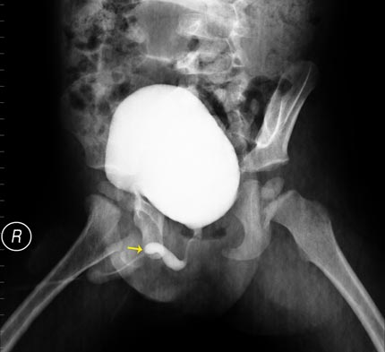
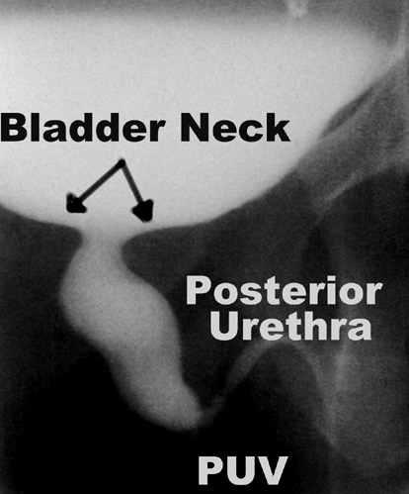
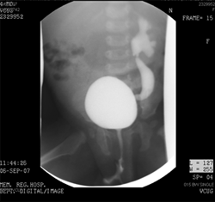
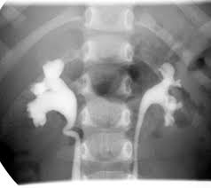
Prof Irimu G W
s
Notes:
c
UTI in Children

Slide 30
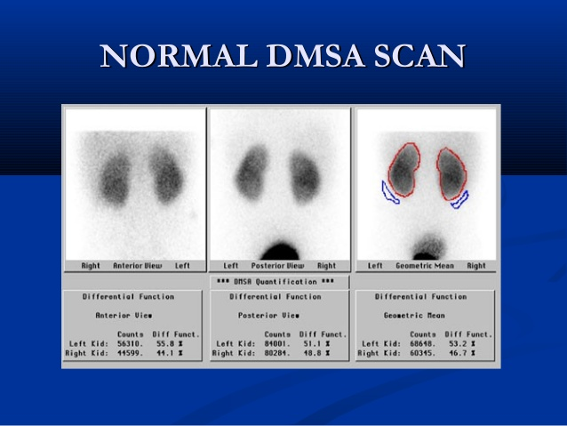
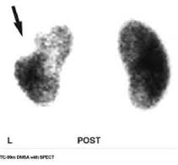
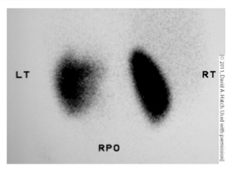
Diagnostic imaging
DMSA scan
Prof Irimu G W

Slide 31
Timing of the MCU
MCU - previously recommended to wait for 4-6/52, after UTI to avoid demonstrating mild reflux 2⁰ inflammatory changes at the ureterovesical junction
But demonstration of even mild reflux at the time of infection is important.
Reflux rarely disappears after Rx
E. Coli endotoxins have smooth muscle paralysing effect & may cause over estimation of reflux
Prof Irimu G W

Slide 32
Who needs to be reffered to a pediatrician/ nephrologist?
Children with abnormal urinary tract – eg posterior urethra valves, vesical ureteric reflux.
Children with recurrent UTIs.
Prof Irimu G W

Slide 33
Follow up
Urine culture 1 week after Rx then every 3 months or any febrile illness.
Ask about
  bowel and voiding habit– frequency, urine holding manoeuvres, hurried voiding, cleaning method, constipation, fluid consumption, sexual activities for older children.
If no abnormalities detected on renal /bladder ultra-sound or on MCU no need for long term follow up.
Parents of children with a confirmed UTI should be instructed to seek medical evaluation early( within 48 hrs) for future febrile illness. Urine specimen should be obtained
Prof Irimu G W

Slide 34
Summary of investigation
Febrile child
Urinalysis , microscopy, c/s
Leukocyte esterase negative , another source of infection
Renal and bladder U/sS
2nd UTI or abnormal U/S
Voiding cystourethrogram
Prof Irimu G W

Slide 35
Prevention of UTI
High fluid intake
Regular voiding
Complete bladder emptying using double bladder micturition
Prevention and treatment of constipation
Good perineal hygiene
Use of prophylactic antibiotics ???? (>2 upper UTIs, 1 upper & 1 lower UTI, >3lower UTIs
Prof Irimu G W

Slide 36
SUMMARY
Accurate diagnosis of UTI is important
Prompt treatment is required in febrile patients.
Renal bladder U/S is indicated in all children with UTI.
MCU is indicated if RBUS suggest high-grade vescical ureteric reflux or obstructive uropathy eg hydronephrosis, scarring
Prof Irimu G W

